Slide 3
EXAMPLES

Slide 6
CULINARY TRAINING PROGRAM

Slide 8
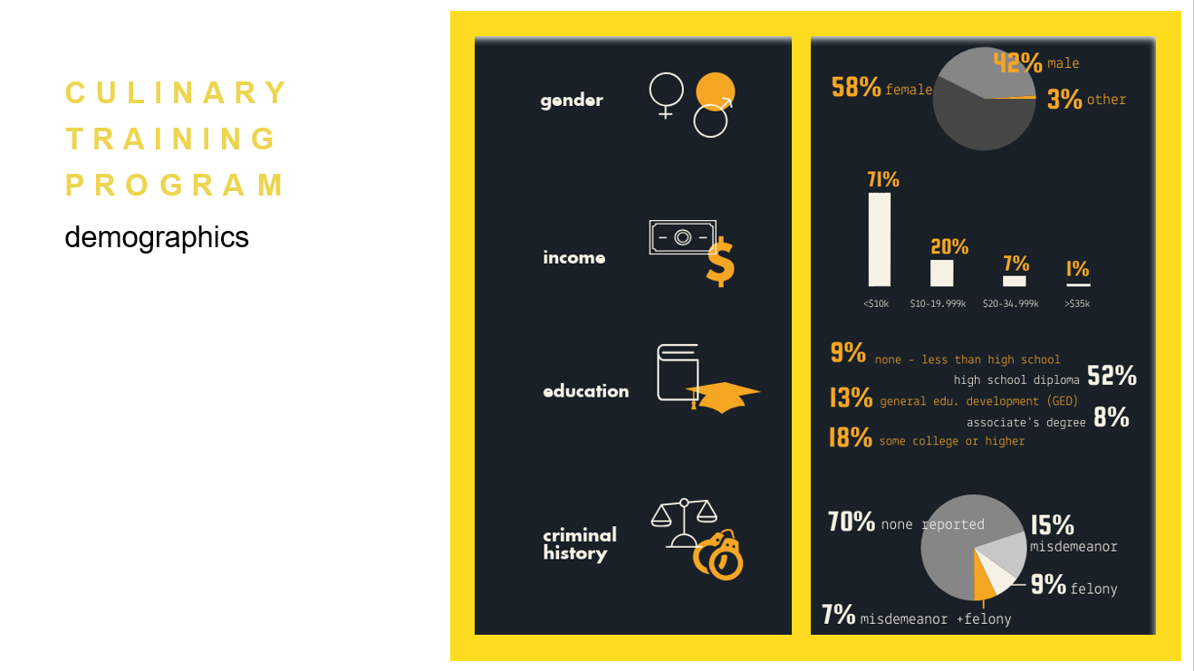
demographics

Slide 9
curriculum components

Slide 10
program
outcomes

Slide 13
professional development aspects

Slide 15
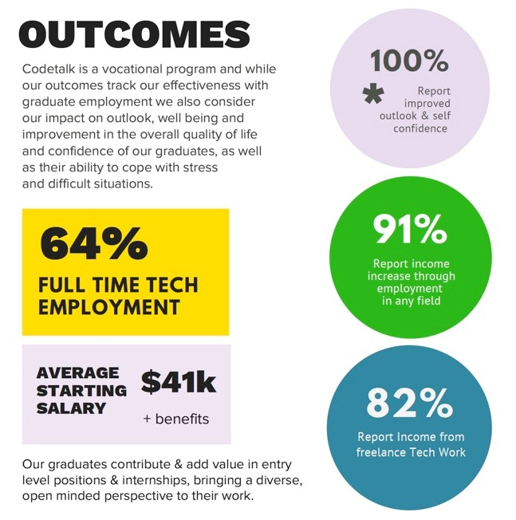
CODETALK
Impact

Slide 16
the bottom line
jobs & career tracks
ctp | codetalk
Prep cook
Catering Cook
Line Cook
Butcher Assistant
Food Stylist
Food Production Assistant

